Slide 1
Canteen Automation System
A Software Engineering project submitted By -
Afid Md Azwad [ 18-38261-2]
Din Mohammad Dohan [17-34465-2]
Tanvir Ahamed [18-37519-1]
Shaiq Sadman [18-39276-3] To Honorable
Shimu Sanjida Afroz [18-37081-1) MASUM BILLAH SIR
Mim Ommay Salma Rahman [18-36021-1] Software Engineering
Ayshi Ashwarya Debnath [18-36042-1] Department of Computer Science
American International University-Bangladesh (AIUB)

Slide 2
Our project is about Canteen Automation system.

Slide 3
Other’s Canteen Disadvantage : Long Queues Before Placing The Order :The experience of ordering in most fast food canteens is not pleasant for customers. Customers have to make long queues before placing the order and when the order is placed they have to wait near the counter until the order is prepared. Communication: The verbal communication between two parties for placing an order and the information about bill should also result in error means error also occurs in understanding what the person wants to say and especially in busy hours in canteens. When the place is very crowded and noisy, miscommunications are common.

Slide 4
Food customization: Food customization allows some flexibility for customers who have a special request (less ice for soda, no pickles etc.) and is especially necessary for customers who are allergic to some ingredients. Currently, the cashier has to memorize these requests since the existing system does not support any means of recording such request. The result is that the requests are forgotten or miscommunication to the cook.
Menu display:
Today's competition between food canteens motivates each canteen to launch new items on their menus on a more frequent basis. However, the menu in more canteens usually attached to a wall behind the counter and the customer are not aware of that new item because the menu is not up-to-date. Furthermore, not all item on the menu list has a graphical illustration to help customers to take Decision easily what they want

Slide 5
Solution to the Problem : Nowadays people are busy with their professional life. So, they don’t want to spend more time in canteen and waiting for the waiter to take their order. Many people visit the canteen at the lunch time. Sometimes they have limited time to take lunch. Here, this software helps them to save time and order meal quickly. They don’t need to call the waiter again and again. With the software customer can be informed about the ordered food that whether it is cooked or not or how much progress is done already. This software will be very helpful for our customer and we will reach our business goal.

Slide 6
PURPOSE OF PROJECT:
Our purpose of the system is to develop a simple Canteen automation Software and implement it, which later will be used for a web-based application.
The proposed "Canteen Automation System" is economically feasible because-
The system requires very fewer time factors as compared to manual system.
The system will provide fast and efficient automated environment instead of slow and error prone manual system, thus reducing both time and manpower spent in running the system.
The system will have GUI interface and very less user training is required to learn it.

Slide 7
Objective Of Project:
Our objective is to make a platform independent application to maintain a database of all orders ordered from various sources and all the different services required by each of them. Established canteen automation practices should provide the needed connectivity and accountability between those two units, and when managed properly, enhances the effectiveness of both operations.
To order food rapidly
To make it convenient for people who have limited time
Cost reduction
Reduced paper work
Computerized Oder and billing system

Slide 8
Advantages:
Completely automated online ordering of food in a canteen.
Order can be placed using personal android phones.
Food ordering pages that look and feel exactly the same as the existing restaurant website
Built-in facility to set modifiers on different menu items
Facility to create modifier groups, individual modifier items and assign modifier items into different groups
Single and individual Admin Panel and login for each Canteen
So, we think there are some solutions of the aforementioned problem. From the internet we saw a solution of the same problem was solved by an institution name GYAN GANGA INSTITUTE OF TECHNOLOGY & SCIENCES. There we can see that they used RAD model to solve the problem. But these problem can also be solved by other agile models as well.
.

Slide 9
Functional Requirement:
Users of the canteen automation system, namely canteen customers, must be provided the following functionality:
Create an account.
Manage their account.
Log into the system
Navigate the canteen's menu.
Select an item from the menu.
Customize options for a selected item.
Add an item to their current order.
Review their current order.
Remove an item/remove all items from their current order.
Provide payment details.
Place an order.
Receive confirmation in the form of an order number.

Slide 10
Quality attributes: Time: The elapsed time between the submission of order process between the customer and cashier in a canteen should be as minimum as possible. User-friendly: Our canteen automation system should be more users friendly. The user interface should be kept simple and uncluttered. Since the different type of people will interact with this process so our project should be very easy to them to understand. Flexibility: Our project should be so flexible that whenever we want to make changes in it very easily it can be done.

Slide 11
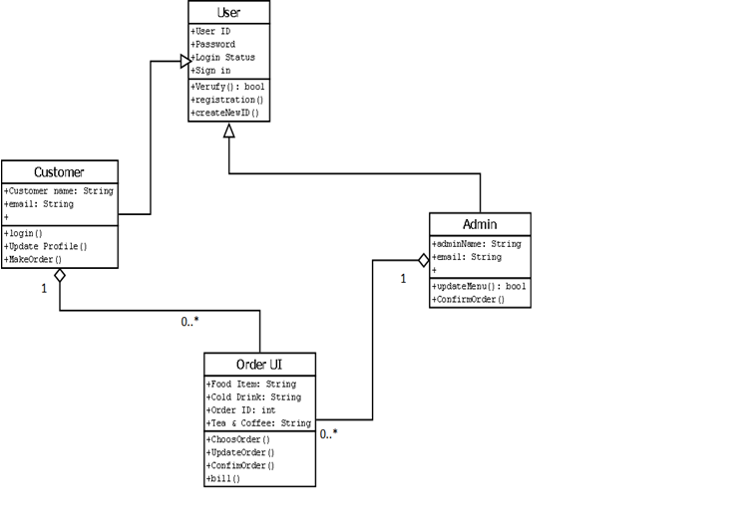
Class Diagram :

Slide 12
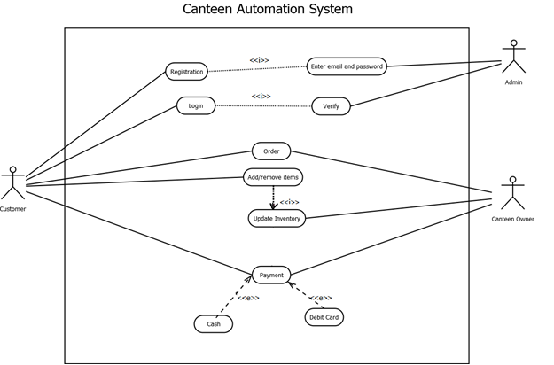
Use case:
Users of the canteen automation system, namely canteen customers, must be provided the following functionality:
Create an account.
Manage their account.
Log into the system
Navigate the canteen's menu.
Select an item from the menu.
Customize options for a selected item.
Add an item to their current order.
Review their current order.
Remove an item/remove all items from their current order.
Provide payment details.
Place an order.
Receive confirmation in the form of an order number.

Slide 13
SOFTWARE DEVELOPMENT LIFE CYCLE :
Process Model :
As our software is about the canteen automation system, so it is must that the product requirements will vary from time to time. In this perspective scrum is the most suitable process model we think. Besides, the model is the most efficient and easiest method for our software. Scrum is a method where daily a meeting is held and in every 24 hours the daily requirements will be fulfilled.
In Scrum method it has three processes they are-
Pre-game (Planning + Architecture )
Game( Sprint + Scrum meeting )
Post-game (Demo + closure )

Slide 14
Pre-game:
Pre-game process has 2 options to complete a software:
1. Planning :
a. Definition of the system being developed
b. A Product Backlog list is created containing all the requirements that are currently known
c. The requirements are prioritized and the effort needed for their implementation is estimated
2. Architecture :
a. The high level design of the system including the architecture is planned based on the current items in the Product Backlog
b. In case of an enhancement to an existing system, the changes needed for implementing the backlog items are identified along with the problems they may cause

Slide 15
Game Phase :
This phase is treated as a "black box" where the unpredictable is expected.
Post phase :
• This phase is entered when an agreement has been made such as the requirements are completed.
• In this case, no more items and issues cannot be found nor can any new ones be invented.
• The system is now ready for the release and the preparation for this is done during the post-game phase, including the tasks such as the integration, system testing and documentation.

Slide 16
Why not Waterfall model?
Waterfall model can be adopted because in our case requirements are known in advance but there are some of waterfall model due to which it is not feasible to adopt:
• No parallelism of work.
• Time consuming.
Why not Iterative model?
In an iterative model, each phase of an iteration is rigid with no overlaps. An iterative method will take 6 months to complete. The software and research has shown that longer iteration have higher complexity and risk.

Slide 17
So, As the environment of the software is quite flexible, that is why we chose the Scrum process model over the other process models. We think it will make our work much easier if we follow Scrum model.
Why not V-model:
Very rigid and least flexible.
Software is developed during the implementation phase, so no early prototypes of the software are produced.
If any changes happen in midway, then the test documents along with requirement documents has to be updated.

Slide 18
Project Roll Identification and Responsibilities :
We are using Scrum Method to develop our software. So, there will be some roles in this project. They are:
Scrum Master
Product Owner
Scrum Team
Customer
Management

Slide 19
Responsibilities of the roles:
Scrum Master:
To develop Canteen Automation software system scrum master is responsible for ensuring that the project is carried through according to the practices, values, and rules of Scrum and that it progresses as planned.
Product Owner:
Product owner is officially response for the project, managing, controlling and making the product backlog list. He makes the final decision of the task related to product backlog.

Slide 20
Scrum Team:
Scrum Team is the project team that has the authority to decide on the necessary actions and to organize itself in order to achieve the goals of each sprint. They are involved in effort estimation, creating the sprint backlog, reviewing the product backlog and suggesting impediments that need to be removed from the project.
Customer:
Our online customers or users will participate in the tasks related to product Backlog items for the system being developed or enhanced.

Slide 21
Management:
Management is in charge of final decision making, along with the agreements, standards, and conventions to be followed in the project. Our Management also participates in the setting of goals and requirements.

Slide 22


Slide 23


